Slide 1
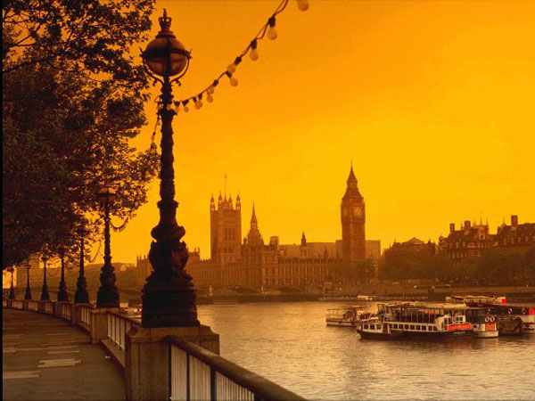
SIGHTS OF LONDON
Monuments you must absolutely see in London !

Slide 2

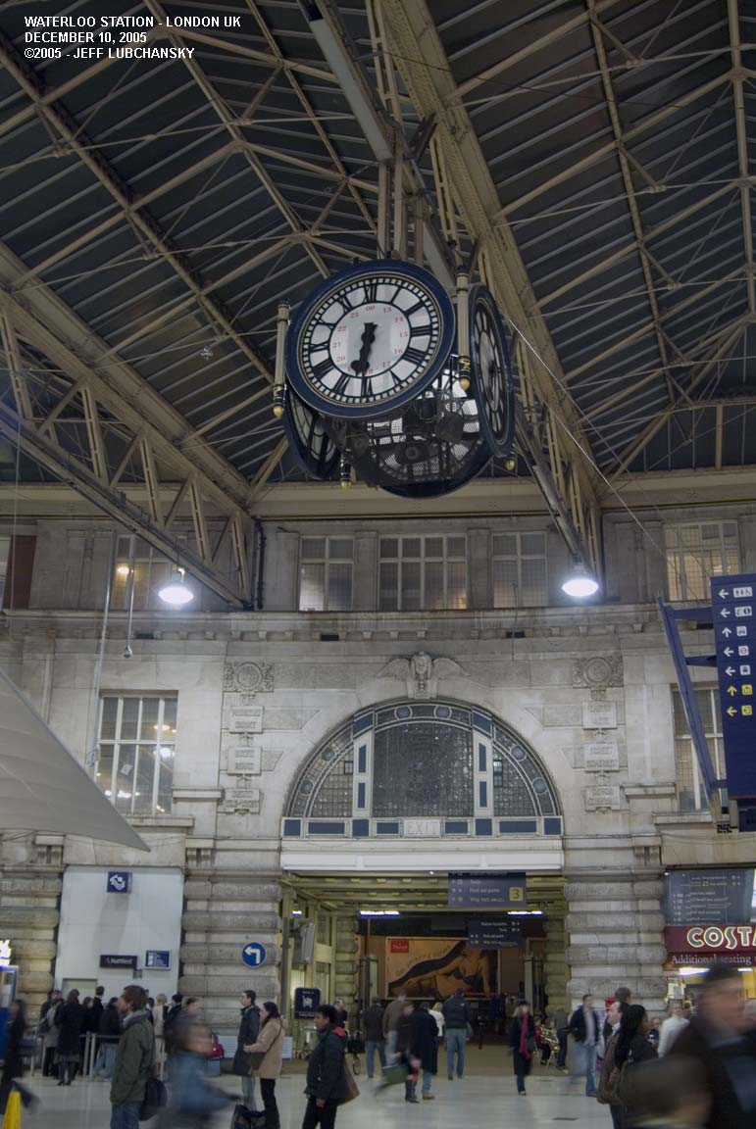
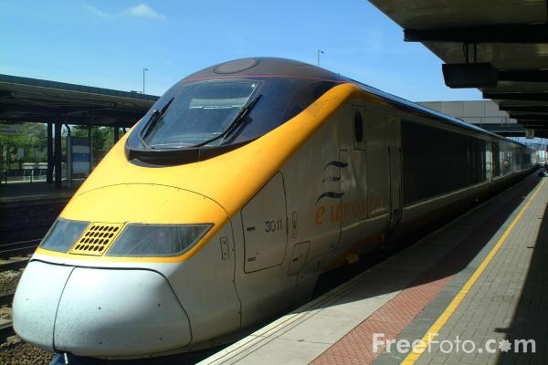

Let’s visit London …
This morning you took the Eurostar from France and now you are at St Pancras.

Slide 3
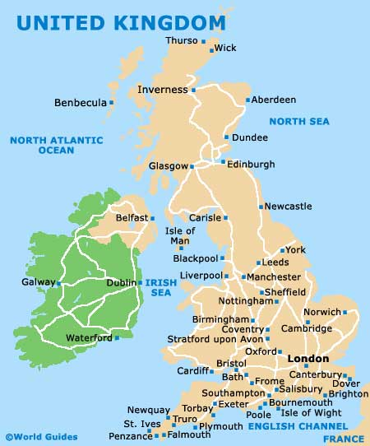

London is a big city. It’s the capital city of England.
There are 8,278,251 inhabitants.
To compare, there are 2,153,600 inhabitants in Paris.

Slide 4

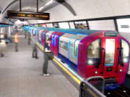
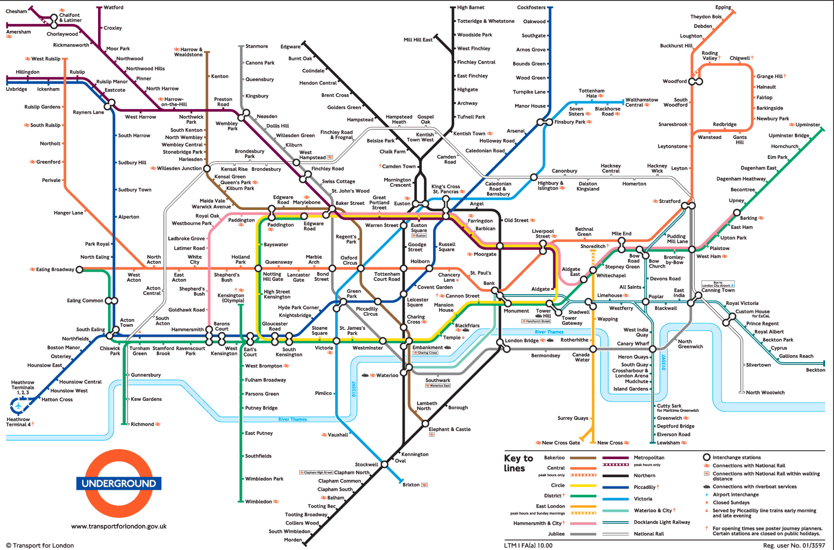
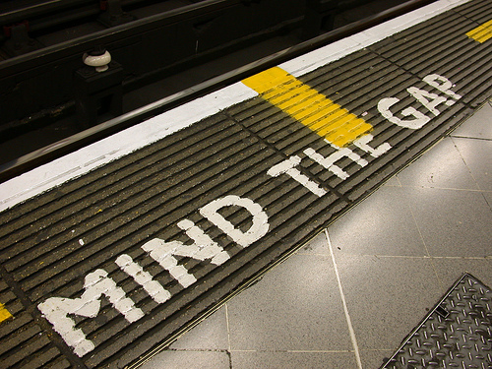
There are a lot of monuments that you can visit.
London is so big that you must take the underground. This is the London underground map:

Slide 5
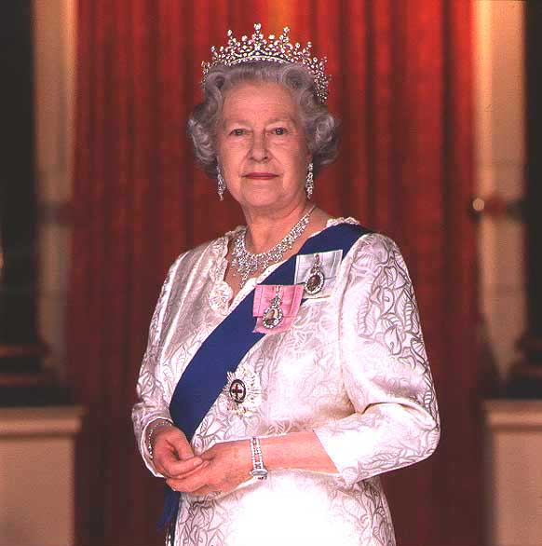
In England, it is a monarchy because there is a queen.
The Queen is Elizabeth II.
She was born on April 21st 1926.
She was crowned on June 2nd 1952.

Slide 6
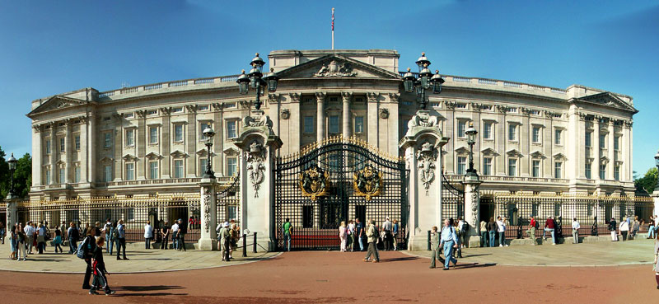
She lives in Buckingham Palace.
A lot of tourists go and see the palace everyday.

Slide 7
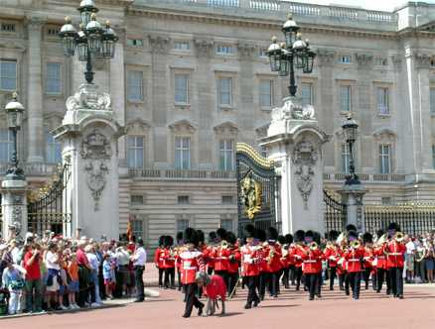
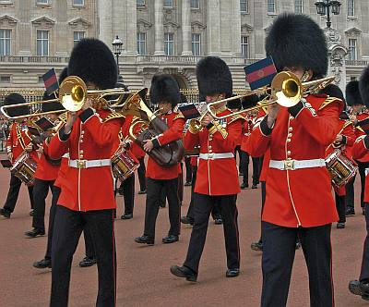
Sometimes you can see the changing of guard.
It is very impressing …

Slide 8
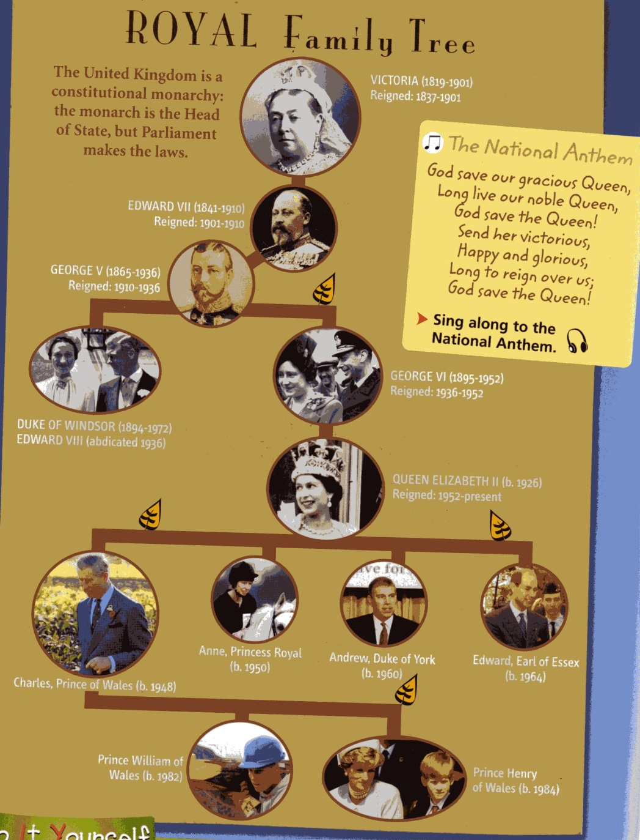
The queen has got a big family :

Slide 9
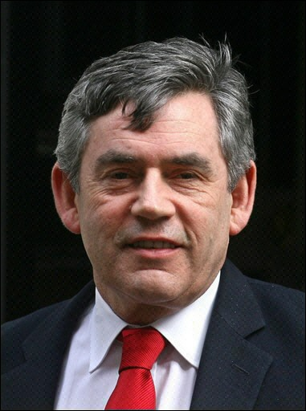
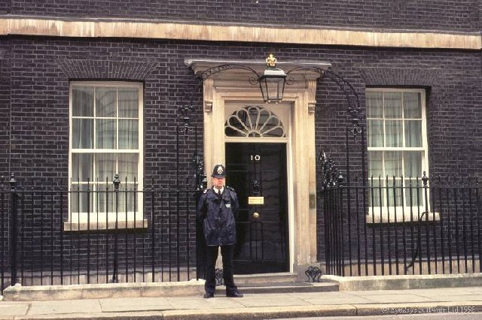
There is a queen but there is also a government, so it is a Constitutional Monarchy. The chief of the government is the Prime Minister:
His name is Gordon Brown. He lives at 10 Downing Street.

Slide 10
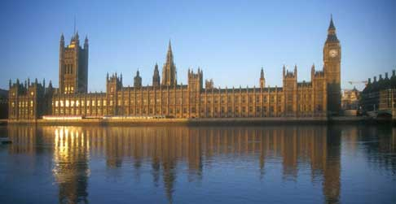
There is also a Parliament. It is composed of two houses:
- The House of Lords.
- The House of Commons.
The members of Parliament (MPs) are elected by the people and they work in the House of Commons.
The Parliament debates and passes the laws (legislation).
Let’s have a look where they work !!!
This is the Houses of the Parliament and Big Ben :

Slide 11
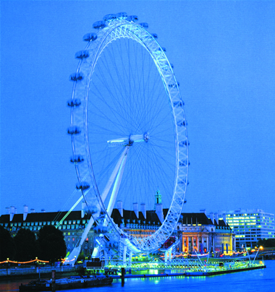
Near the parliament and the river Thames, you can see a huge wheel :
The London Eye :
The London Eye is 135 metres high !

Slide 12
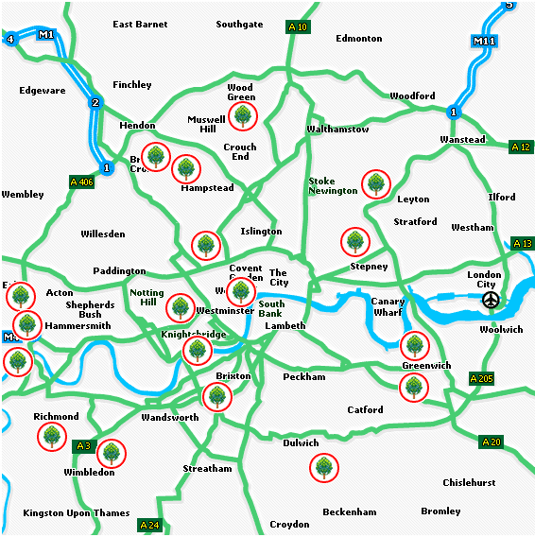
After having visited these monuments, I imagine you want to have a break.
London city is ideal because they are many parks :

Slide 13
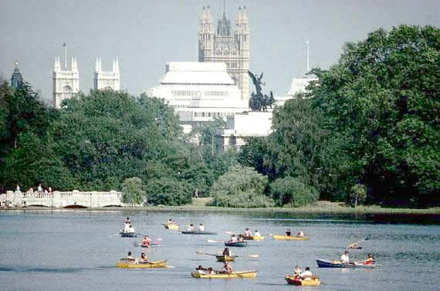
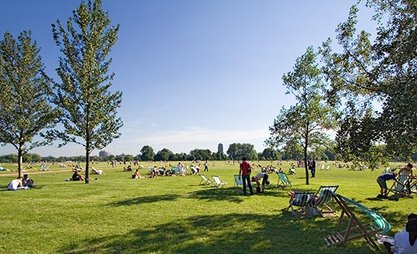

One of the most popular is Hyde Park.
You can go for a walk, cycle, row a boat or roller-blade in this vast park.

Slide 14
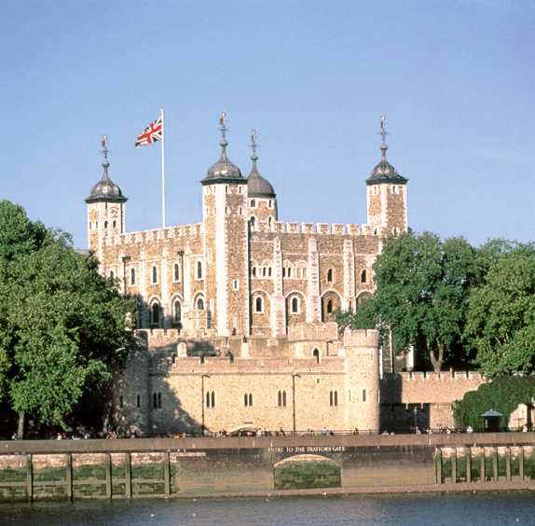
After a little break, it is time to visit other monuments …
Look at this photo … you know this monument !!!

Slide 15
If you don’t remember,
I will help you …

Slide 16
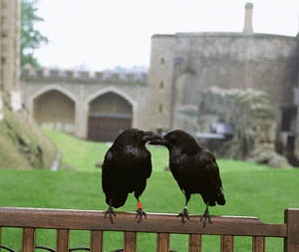
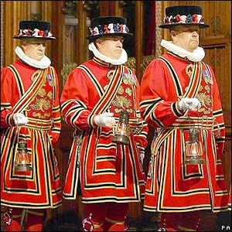
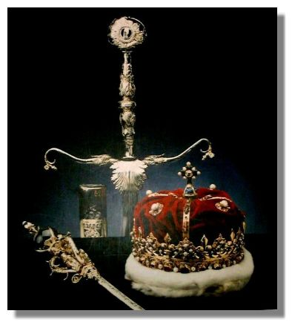

Slide 17


Slide 18

Of course, it is the Tower of London !!!!
Let’s go somewhere else … don’t forget it was a prison before!!!

Slide 19
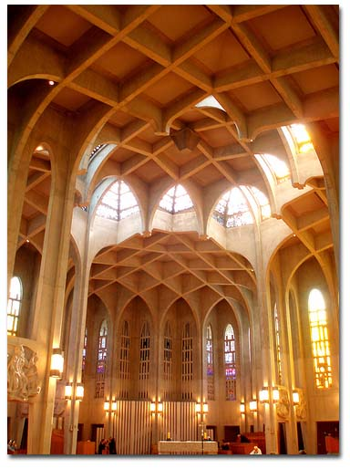
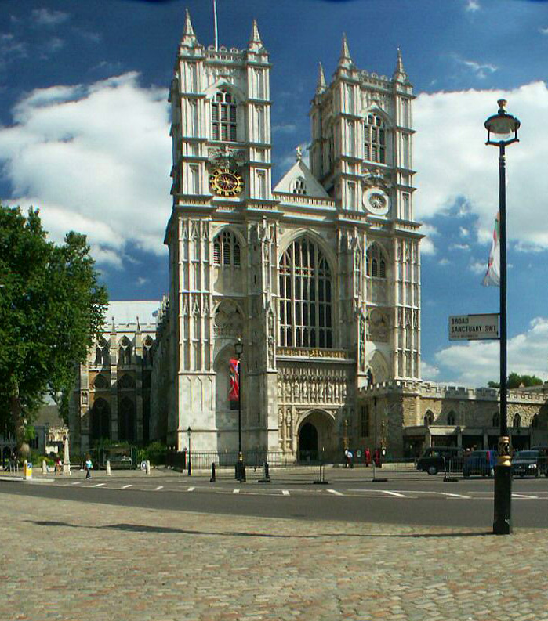
When the Royal Family organizes very special events : marriages, funerals or royal coronations, it is in Westminster Abbey :
Outside Inside

Slide 20
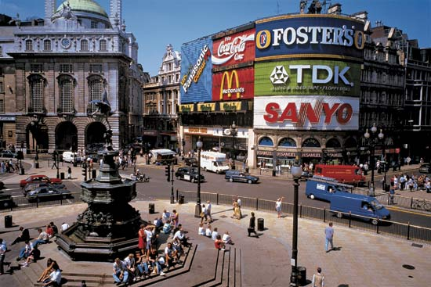
Now, it is time to do shopping.
You can meet your friends at Piccadily Circus.
This famous crossroads is near shops and theatres, so you can do shopping and then see a musical !!

Slide 21

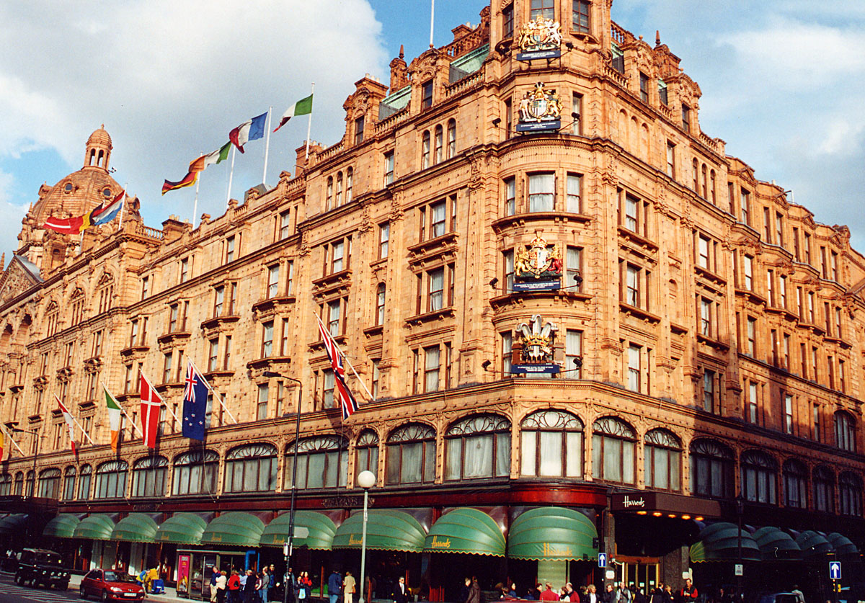
If you want to do shopping, you can go to Harrods.
Harrods is a very famous department store … but the problem is that it is very very expensive. There are only luxurious products !!!

Slide 22

Have a look inside!

Slide 23
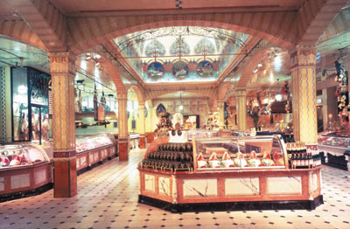

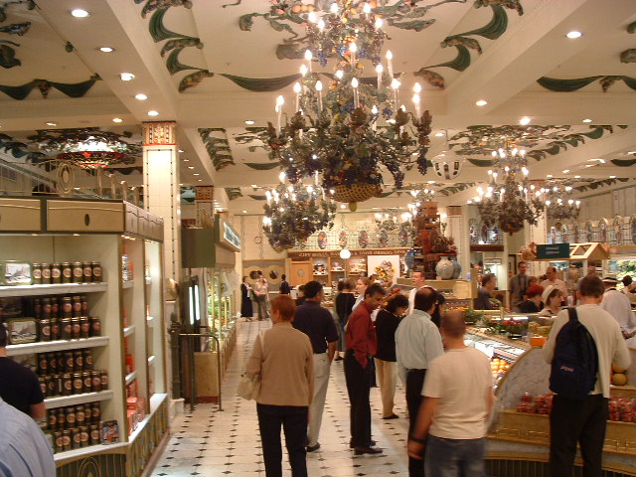

Slide 24
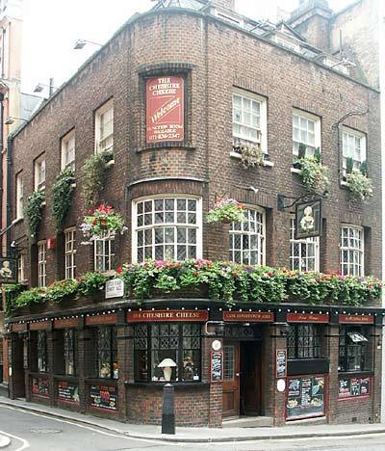
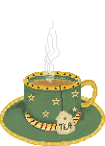
Now it is 6 pm … time for a drink !
This is a typical English pub.
English people like to gather for a drink or eat after work.
They can talk and relax !
The atmosphere is always great !!

Slide 25
It is time to go back to France !
Bye Bye London and see you soon !!!!!!!

